Slide 1
Learning MERN
Hein Arkar
Brillar

Slide 2
Overview
Clean Code
MERN
Tailwind, MUI
Typescript
Socket, Redis
Architecture

Slide 3
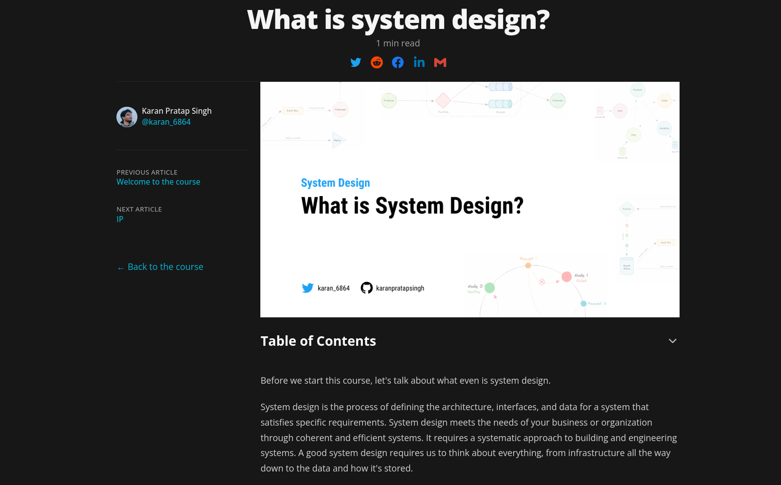

System Design
https://www.karanpratapsingh.com/courses/system-design/what-is-system-design

Slide 4
System Design
Requirements
Functional Requirements
Non-functional Requirements
Extended Requirements
Estimation and Constraints
Traffic, Storage, Bandwidth
API Designs
4. High Level Design
Architectures
5. Detailed Design
Data Partitioning
Caching
Content Delivery Network

Slide 5

Architectures
Monoliths vs Microservice

Slide 6
Monoliths
Microservice
Modular Monoliths
Single application structure
Developed as a cohesive unit
Challenging to scale
Entire application redeployed for updates
Composed of multiple, independent services
Decoupled architecture
Easier to maintain and scale
Updates applied to individual services

Slide 7
Cloud Basic
NGINX
Scaling
Horizontal & Vertical
Load Balancing
Round – Robin
Least Connected
Ip – hash (session persistence)
Weighted
Load Balancer
Terraform
Infrastructure as Code

Slide 8
Security Testing
Software Composition Analysis
verification of the third-party libraries, frameworks and components used within our application
Static Application Security Testing
analysis of written code (compiled or uncompiled) for security vulnerabilities.
Dynamic Application Security Testing
Analysis of running application with the purpose of finding and managing vulnerabilities it may have.

Slide 9
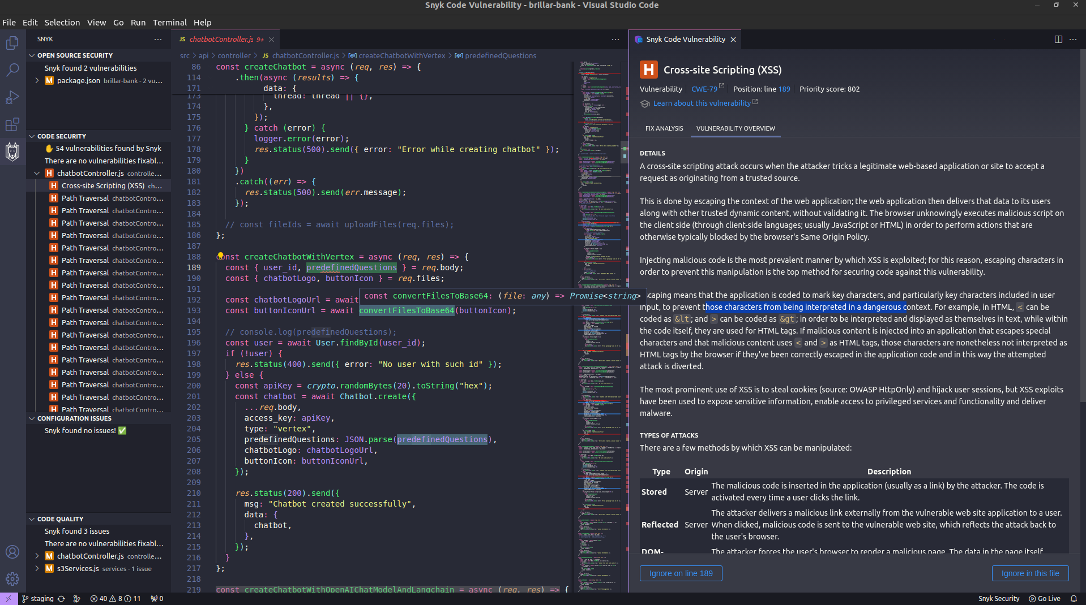
SNYK
Secure by identifying and managing vulnerabilities in project's dependencies
Snyk auth
Snyk test

Slide 10
Payment Gateways
2C2P
provides a wide range of powerful online payment solutions which allows online merchants to process credit / debit card and alternative payments
Card payments ( Visa / MasterCard / Amex / JCB / CUP / Diners / Discover )
Wallet payments
Alipay
Google Pay
Apple Pay
Line Pay
Samsung Pay
WeChat Pay
Dinger
enables businesses in Myanmar to accept digital payments from any accounts in the most simple and efficient way. Do more with less.

Slide 11
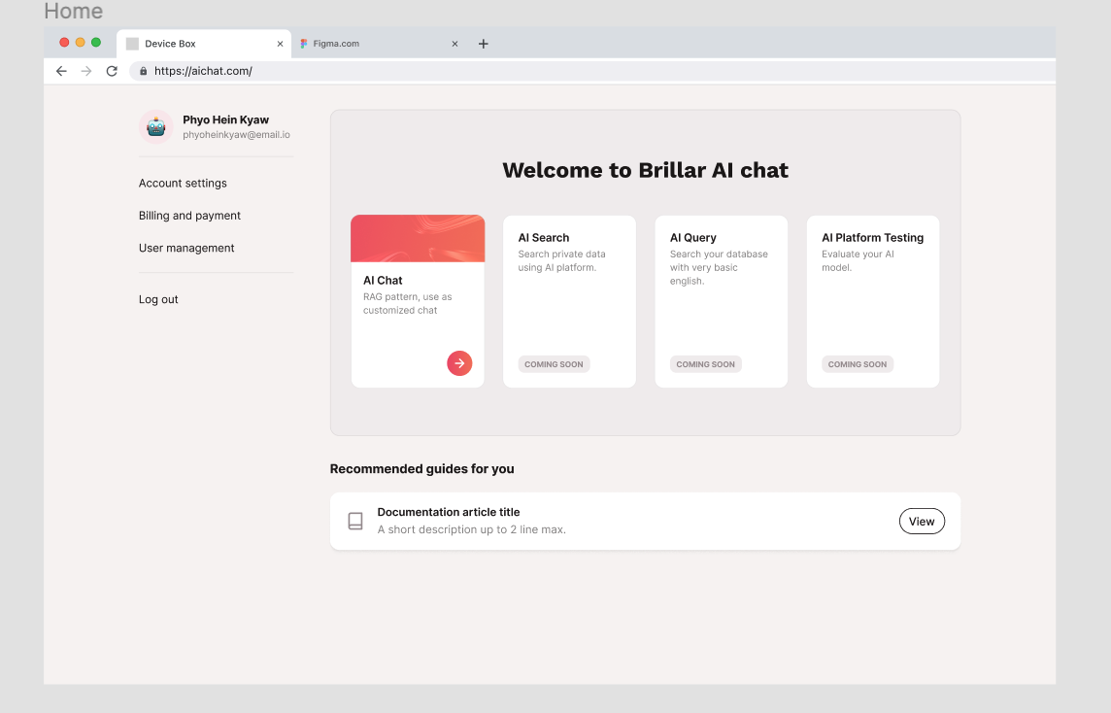
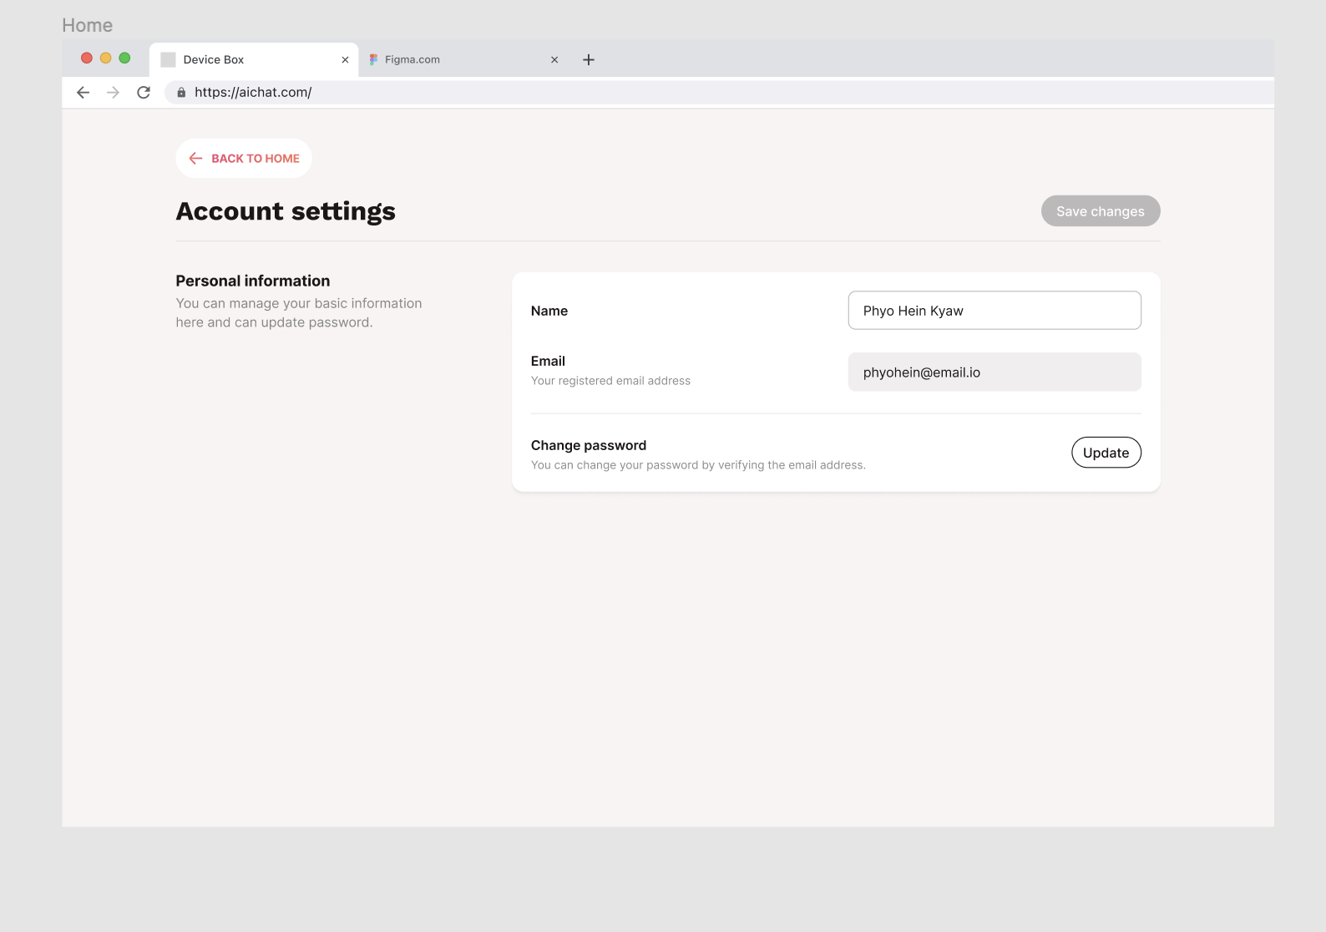
ECAI Tasks

Slide 12
Questions & Answers
Thank You Very Much

